Slide 1
U.S. Small Business Administration

Slide 2
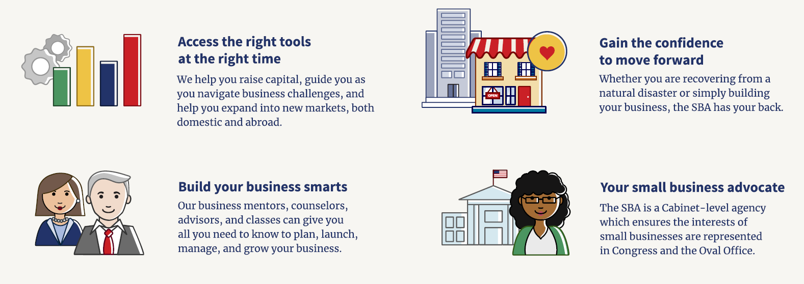
SBA Overview
The U.S. Small Business Administration makes the American dream of business ownership a reality.

Slide 3
The Right Tools at the Right Time
CAPITAL
Start or expand your business with SBA-guaranteed loans
Use Lender Match to find lenders and capital
CONTRACTING
Provide goods & services to the government
Register as a government contractor for opportunities
COUNSELING
Mentoring
Free business consulting and low cost training

Slide 4
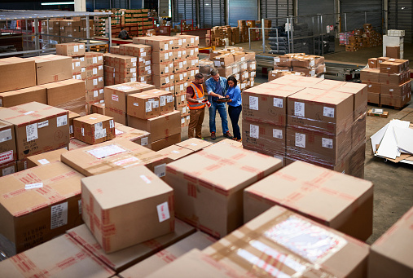
Conventional Lending Model: Low-Risk Clients
Disproportionately benefits:
Established businesses
Stable cash flow
Proven financials

Slide 5
Benefits of SBA Lending

Slide 6

Benefits for Borrowers
Reasonable term loans for which they may not otherwise qualify
Smaller equity requirements mean
lower down payments
Longer repayment terms mean lower monthly payments and increased cash flow

Slide 7
More Features & Benefits
SBA’s loan programs allow for the following:
Projection Based Lending (Start-ups and Expansions)
Lending with Collateral Shortfalls
Lending for multiple business purposes including working capital, inventory, leasehold improvements, & real estate
Financing Changes of Ownership
Refinance of Business Debt

Slide 8
Access to Capital
Uses & Requirements

Slide 9
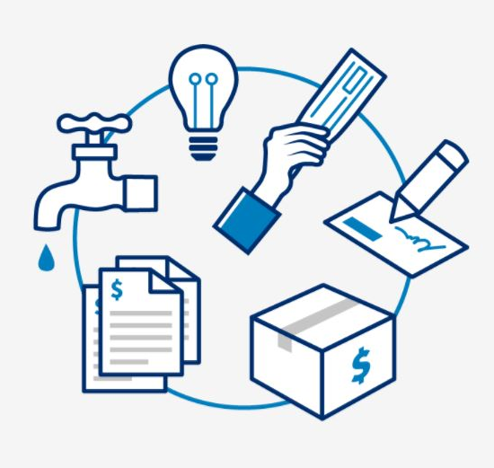
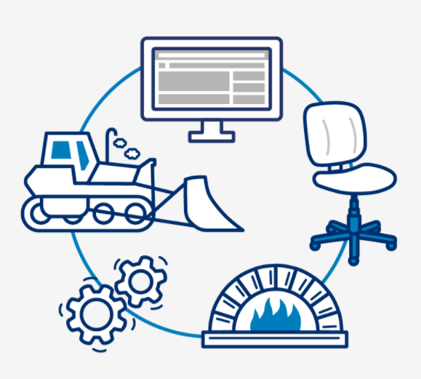
Capital: Uses
Get $500 to $5.5 million to fund your business.
Working Capital: Seasonal financing, export loans, revolving credit & refinanced business debt.
Fixed Assets: Furniture, real estate, machinery, equipment, construction & remodeling

Slide 10
Use of Proceeds- Farms
• Purchase of land, building, and land improvements as part of an eligible project;
• Construction, renovation, or improvement of farm buildings other than residences;
• 7(a) Only:
• Purchase of farm machinery and equipment;
• Purchase of seed and acquisition of animals;
• Operating expenses directly related to the farming operations, excluding personal or family living expenses; and
• Refinancing of debt related to the farming operation, excluding personal or family debt, provided the refinancing meets SBA loan Program Requirements.
NOTE: the acquisition of land in excess of the farming operation’s needs is not an eligible use of proceeds (SOP Reference - page 34)

Slide 11
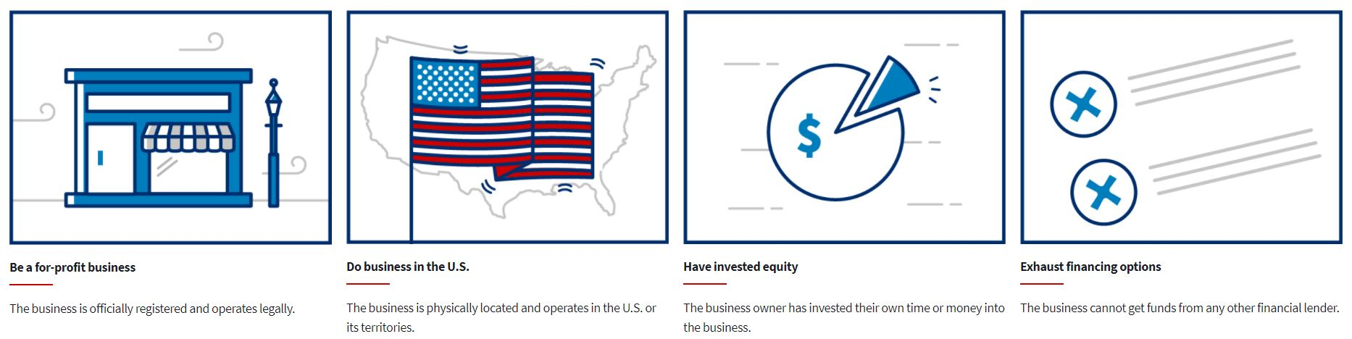
Capital: Requirements
. The SBA works with lenders to provide loans to small businesses. We do not lend directly to small business owners.
Be a for-profit business: The business is officially registered & operates legally.
Do business in the U.S.: The business is physically located & operates in the U.S. or its territories.

Slide 12
Capital: Requirements
Ineligible Businesses
Non-profits
Passive holder of real estate
Owned by non-citizens
Gambling
Restricting patronage
Promoting Religion
Consumer & Marketing co-ops
Prurient nature
Poor character
Prior loss to government

Slide 13
SBA Lender Types
Notes:
.

Slide 14
Lender Types
Conventional Lenders
Credit Unions
Non-Bank Lenders
Mission-based Community Lenders
  Certified Development Companies (CDC)
  Community Advantage Lenders
  Microlenders

Slide 15
Certified Development Companies
SBA 504 Loans
State of Ohio 166 Loans
Some Local Loan Programs

Slide 16
SBA Loan Programs

Slide 17
SBA Loan Programs
504 Loan
7(a) Loan
Microloan
Community Advantage Loans
International Trade Loans

Slide 18
Access to Capital
7(a) Programs

Slide 19

CAPITAL: 7(a)
The 7(a) loan program is the SBA’s primary program for providing financial assistance to small businesses.
Standard 7(a):
-Maximum loan amt: $5M
-SBA aggregate exposure: $3.75M
7(a) Small Loan:
-Maximum loan amt: $500K
-SBA aggregate exposure:
-85% for loans up to 150K
-75% for loans greater than 150

Slide 20
7(a) Loan Programs
Provides funds for a variety of uses
Federally-guaranteed loans up to $5 Million
Competitive loan terms
Term loans or revolving lines of credit
Robust secondary market and CRA credits

Slide 21

Capital: Exporting
Export Express Loan: Typically approved within 36 hours & can be up to $500,000.
Export Working Capital Loan: Can apply in advance of finalizing export sale/contract. Approved within 5-10 days & can be up to $5 million.
International Trade Loan: Combination of fixed asset, working capital financing & debt refinancing. SBA’s maximum guaranty of 90%. Up to $5 million.

Slide 22
7(a) Loan Program: International Trade Loans
Helps small businesses expand globally
Guaranties from 75 percent to 90 percent
Offers three specific loan programs:
  International Trade Loan Program
  Export Working Capital Program
  Export Express

Slide 23
7(a) Loan Program: Community Advantage
Originated and serviced by mission-based lenders
Focus on underserved markets
Receive loan guaranties up to 90 percent
Secondary market profits can be reinvested back into the community
  There are 3 CA Lenders in the Columbus District counties
    ECDI
    Finance Fund
    CCDC

Slide 24
7(a) Loan Program: Veterans Advantage
Standard 7(a) loan structure and terms
At least 51-percent ownership by veterans or military spouses
Fee relief on small dollar SBA guaranteed loans
Fees are waived for ALL Express loans to veterans up to $1Million
  NOTE: FY 2025 (starting 10/1/2024): All 7a Loans Less than $500,000 have fee relief
    Includes Express
    Includes 7a Small Loans
    Includes Regular 7a

Slide 25
Access to Capital
504 Program & Microloans

Slide 26
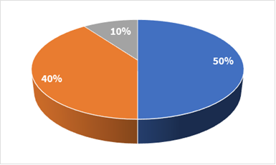
504 Loan Program
Strengthened collateral position
No SBA lending history required
CDC processes SBA paperwork
Qualifies for CRA credits
Mitigates HVADC concerns

Slide 27
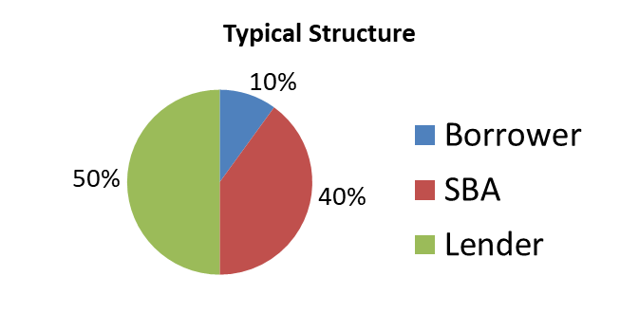
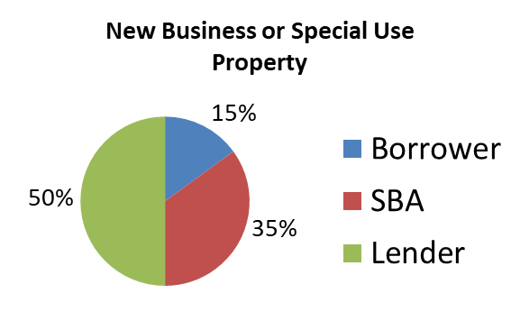
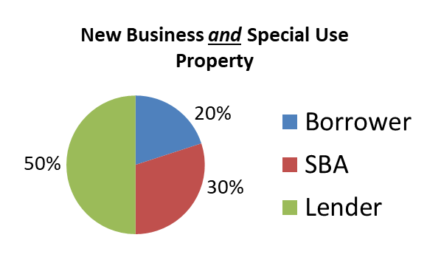
Financing Structures

Slide 28

Microloan Program
Mission-based lenders and nonprofits
Microloans of up to $50,000
Interest rates negotiated by lender
Eligible for annual Technical Assistance Grant
Eligible to be Community Advantage lender
Use of Lender Match for lead generation

Slide 29
Microloans
Up to $500,000 using multiple funding sources
  Start-ups usually limited to max of $75,000
For equipment, inventory, working capital
Rates determined by funding source (10% on average)
Terms up to 5 years
10% down payment

Slide 30

Lender Match
Lender Match is a user-friendly website that connects participating SBA lenders with small business borrowers.
Lender Match can increase your reach to
borrowers outside of your local area.
Lenders can select referral search criteria
to better target customers who meet
their requirements.

Slide 31
Contact Us
More Resources and Assistance in Preparing your Financials and Business Plan
SBA District Office | Columbus | U.S. Small Business Administration
Small Business Development Center | Small Business Development Center
SCORE Mentors | Columbus OH | SCORE
Women’s Business Center | Women's Business Centers of Ohio | ECDI
Veteran Business Outreach Center | https://www.vetbizcentral.org/
Lender Match | https://lending.sba.gov/lender-match/

Slide 32
Want to Learn More?
Jerome W. Jones
Jerome.jones@sba.gov
David M. Townsend
David.townsend@sba.gov
(614)427-0407

Slide 33
U.S. Small Business Administration

